Slide 1
INTEGRAL
“INitiative to bring the 2nd generation of ThermoElectric Generators
into industrial ReALity”
SAFETY ASPECTS IN PILOT LINES – EPPN-NSC i2L joint session
7 November 2018, Grenoble, France
Jean-Yves Escabasse, CEA Liten, Grenoble, France
H2020 Project – Funded by the European Commission under Grant Agreement 720878

Slide 2
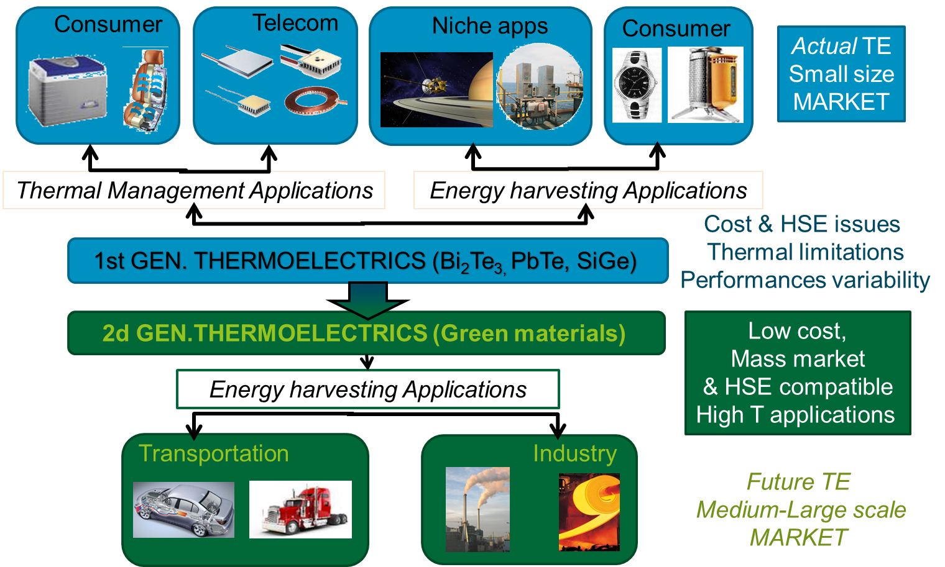
CONTEXT AND CONCEPT
Current TE MARKET:
Small Size
The past
Rare and toxic
raw materials
Niche markets
Half-Heusler
and Silicides
TE Materials
the best GEN2 TE candidates for mass production
The future
with
INTEGRAL

Slide 3
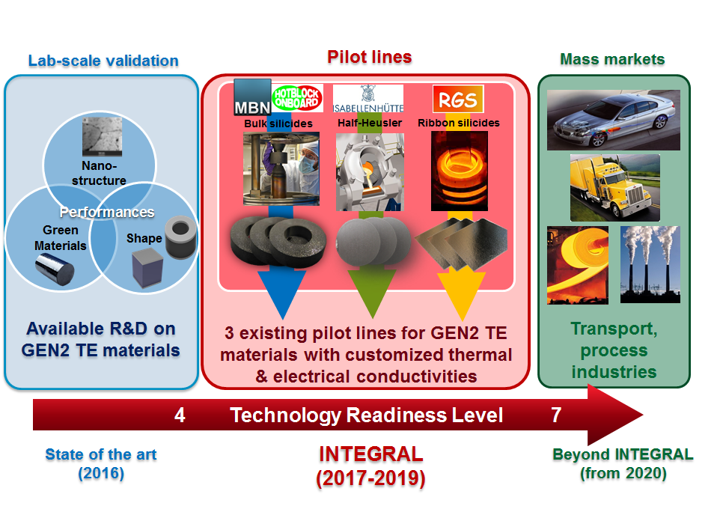

INTEGRAL CONCEPT
To upscale the GEN2 TE material technology and address mass markets

Slide 4


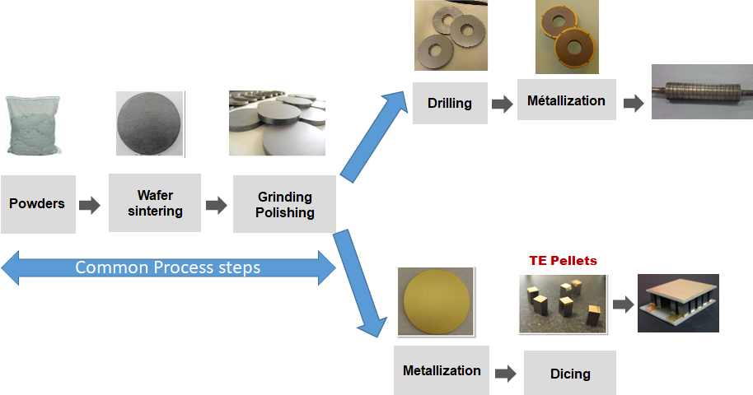
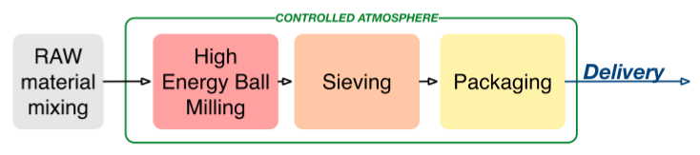
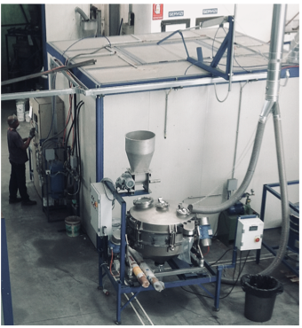
Bulk Silicide TE modules
INTEGRAL Project
Conventional TE module design

Slide 5

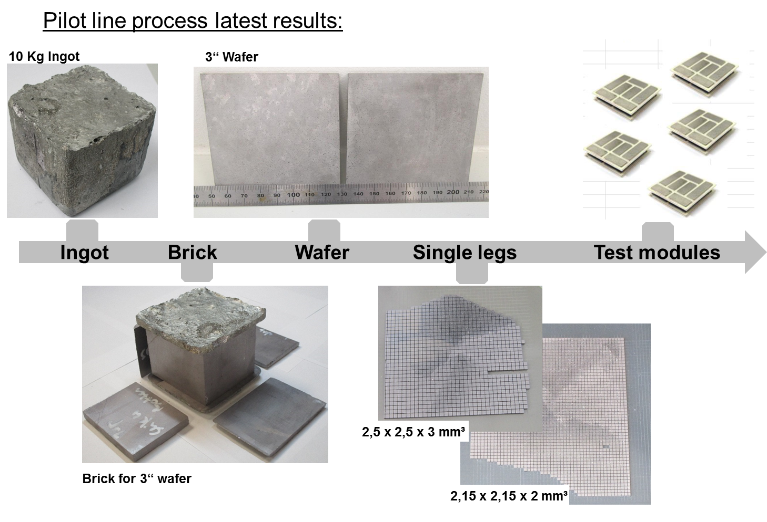
Half-Heusler-based TE modules

Slide 6
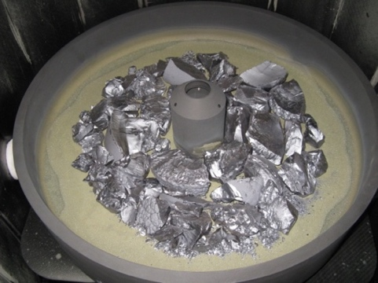
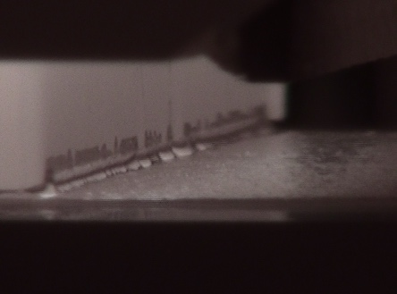
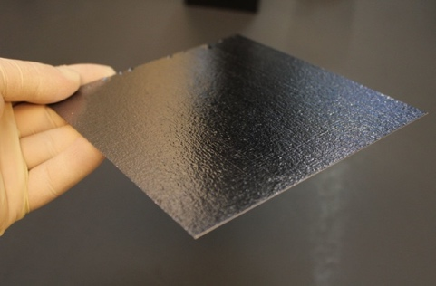
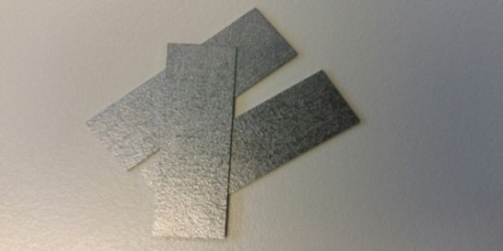
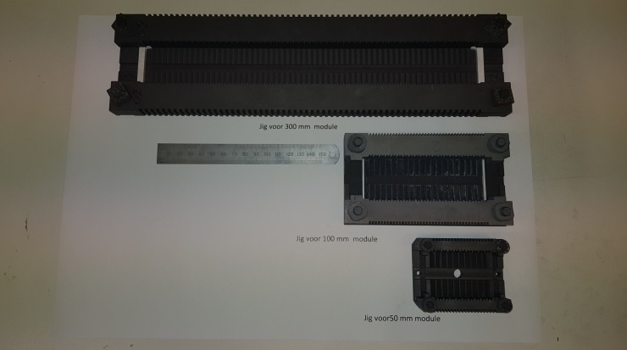
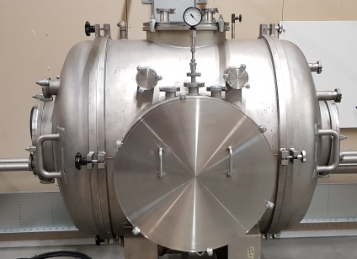
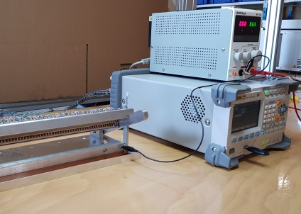
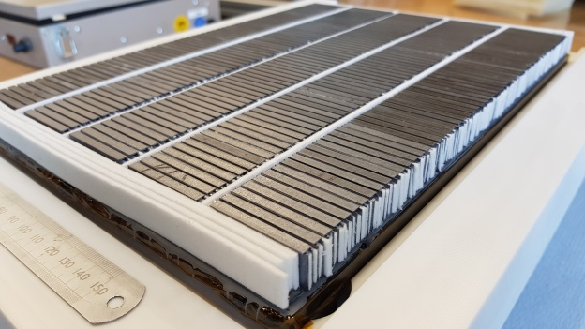
Thermagy manufacturing process
Cast Silicide Material manufacturing
Melting
Casting
Polishing
Dicing
Module manufacturing
Panel assembly
Leg assembly
Brazing
Testing
Mounting

Slide 7
Summary: (nano)-hazard assessment
Size-related hazards
  Pre-alloying and nano-structuring by HBEM
  Many particle-generating process steps, e.g. dicing, grinding, polishing
Fire and explosion hazards
  Finely divided metals, e.g. Si, Mg, Ge, Ni, Zr
Health hazards
  Concern with e.g. Co, Ni, Sb
Occupational safety hazards

Slide 8

Don’t hesitate to contact me
Thanks for your attention
Jean-Yves ESCABASSE
Project Manager Thermoelectricity and 3D Printing
Novel Materials Technologies Department
Laboratory of Modeling and Materials for Metallurgy
French Alternative Energies and Atomic Energy Commission
T. +33 4 38 78 66 17
jean-yves.escabasse@cea.fr www-liten.cea.fr
https://www.linkedin.com/in/escabasseinnovator/

